Slide 1
GEO, Blue Planet and MBON
Francisco Chavez
MBARI
GEO = Group for Earth Observations
MBON = Marine Biodiversity Observation Networks

Slide 2
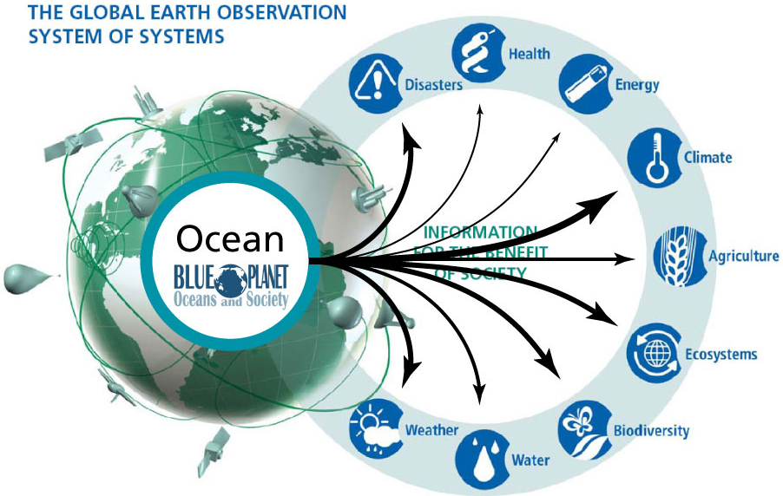
GEO Plenary after 1st Blue Planet meeting in Brasil
(at Blue Planet gave talks on OceanSites and GEO BON)
Notes:
Ocean biological observations are critical in monitoring the health of ocean ecosystems and biodiversity, and the way ecosystem services are being impacted by a changing environment. They are also important in managing fisheries, which fall into the Agriculture SBA.
So ocean observations in some way contribute to each of the 9 GEO Societal Benefit Areas. In Blue Planet gave talks on OceanSites and GEO BON – not sure what has happened between Blue Planet and OceanSites but Richard Lampitt has remained engaged.

Slide 3
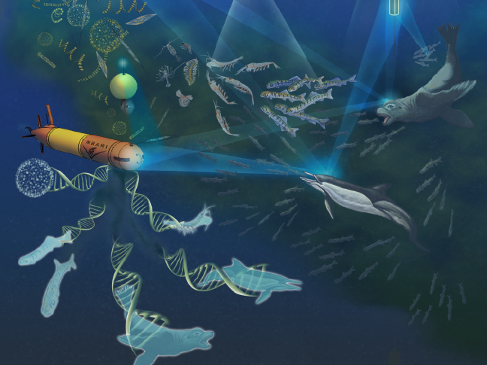
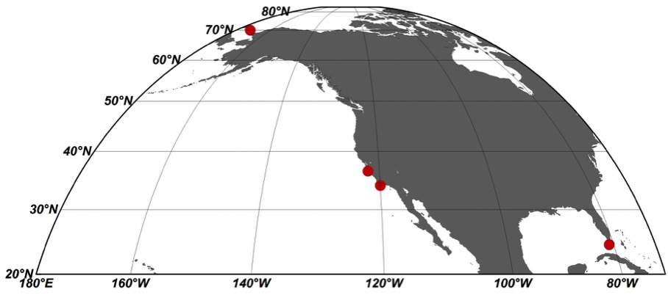
Marine Biodiversity Observation Network (MBON) Demonstration
GEO Ministerial and Plenary, Mexico City, November 2015
Chukchi Sea
Monterey Bay
Channel Islands
Florida Keys
Notes:
National Ocean Partnership Program (NOPP) issued a call for proposals in late 2013 in support of demonstration MBONs
Three proposals selected, one in the Channel Islands, a second in the Arctic/Alaska region and a third in the Florida Keys and Monterey Bay National Marine Sanctuaries – projects initiated late 2014
CeNCOOS, MBARI, MBNMS, Stanford (COS), SWFSC part of Monterey Bay component. Small amount of work at Flower Garden Banks.
NASA, NOAA (IOOS, SWFSC, NMS), BOEM, Shell sponsors (~17 M total)
Smithsonian Tennenbaum MBON natural partner

Slide 4
GEO Programme Board
The GEO Programme Board was established as part of the development of the GEO Strategic Plan 2016 - 2025 and approved at the Mexico City Ministerial Summit in November, 2015.
The Programme Board oversees the establishment of the multi-year GEO Work Programmes and works to align proposed activities with GEO priorities and committed resources. The Programme Board reports to the GEO Executive Committee and Plenary. GEO Members and Participating Organizations nominate representatives to the Programme Board.
Members of the Board dialogue with contributors to the GEO Work Programmes, connecting ideas and contributions to GEO’s Strategic Objectives to advocate, engage and deliver Earth observation data and information, as well as to support the use of the newly established four Implementation Mechanisms for GEO activities
Programme Board had its first meeting February 2-3, 2016 in Geneva

Slide 5
GEO's Core Functions
Identifying user needs and addressing gaps in the information chain
Sustaining foundational observations and data
Fostering partnerships and mobilize resources
Advancing the Global Earth Observation System of Systems (GEOSS) and best practice in data management and sharing
Implementing sustained global and regional services
Cultivating awareness, building capacity and promoting innovation

Slide 6
Societal benefit areas
SBA1
SBA8
SBA2
Foundational Activities
Observations
Information systems (of systems
SBA7
SBA3
SBA6
SBA4
SBA5

Slide 7
Implementation Mechanisms for GEO activities
Foundational tasks (Obs, GEOSS, CB, Secretariat)
Community activities (Develop concepts, applications)
GEO Initiatives (Develops prototype services, Member/POs coordinate)
GEO Flagships (Develops pre-operational services, Member/POs operate)
Going forward GEO should give priority to the in-situ observations because they are more complex, unevenly distributed in space and time, heterogeneous and less organized. Given that in-situ and satellite observations are intimately related and dependent, a proposal was put forth for GEO to consider the formation of a new oversight committee with 4 co-leads from Participating Organizations (POs) with expertise in satellite (2) and in-situ (2).

Slide 8
Societal Benefit Area
Flagship
Analysis, Products
Flagship
Analysis, Products
Flagship Analysis, Products
Initiative
Analysis, Products
Initiative
Analysis, Products
Initiative
Analysis, Products
Initiative
Analysis, Products
Activity
Analysis, Products
Activity
Analysis, Products
Activity
Analysis Products
Foundational Activities
Observation Systems,
Information Systems (of systems)

Slide 9
Next week in Geneva (May 2-4), 1st GEO Work Programme Symposium (WPS) where CA, Initiative, and Foundational Task leads will meet with the Programme Board and GEO Secretariat to prepare for the next three years (2017-2019), followed by the 2nd Programme Board meeting.
Blue Planet proposes to be a GEO Initiative and has prepared an implementation plan for the WPS

Slide 10
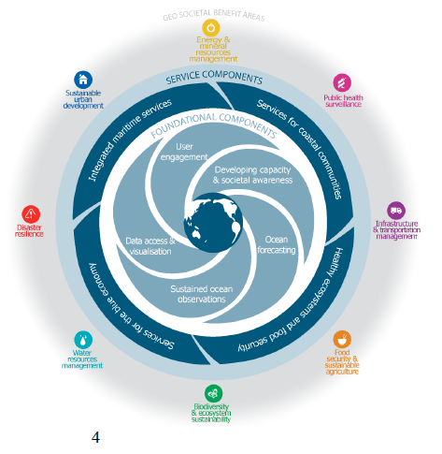
Blue Planet Conceptual Diagram. The inner circle illustrates the five Foundational Components that all rely upon each other and collectively underpin the four Service components. Part of Blue Planet Implementation Plan

Slide 11
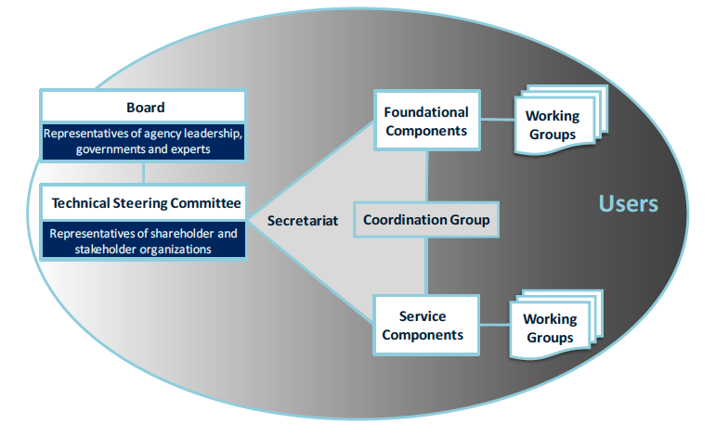
Blue Planet Organizational Structure

Slide 12
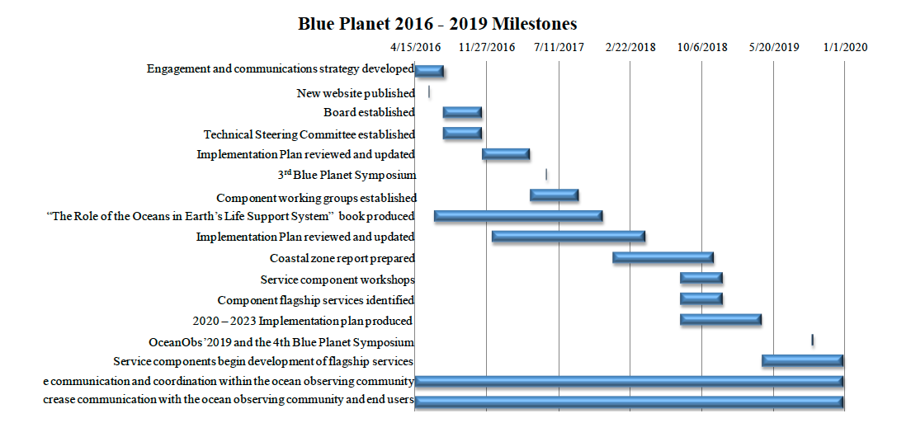
Blue Planet Implementation Timeline

Slide 13
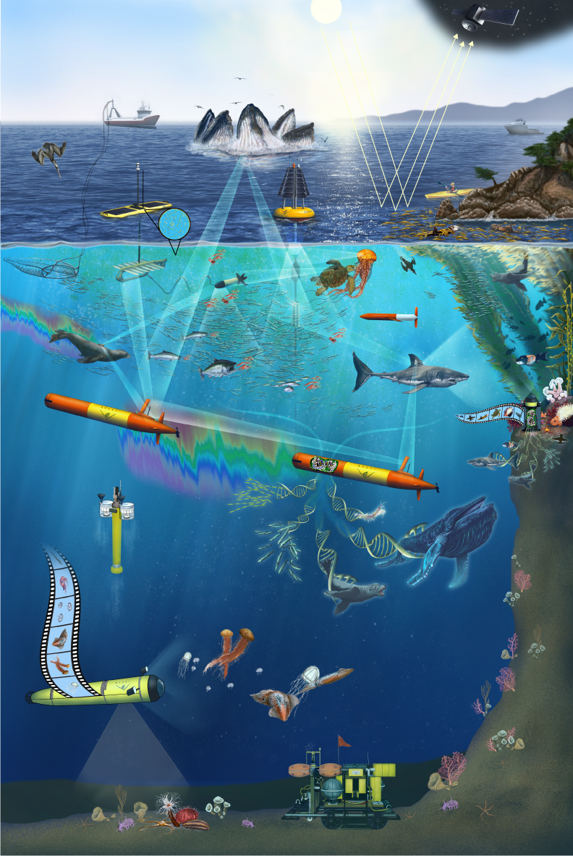
Marine Biodiversity Observation Networks (MBON)

Slide 14
Background
National Ocean Partnership Program (NOPP) issued a call for proposals in late 2013 in support of demonstration Marine Biodiversity Observation Networks (MBON)
Three proposals selected, one in the Santa Barbara Channel, a second in the Arctic/Alaska region and a third in the Florida Keys and Monterey Bay National Marine Sanctuaries
NASA and NOAA (IOOS, SWFSC) sponsors -5 years about $17M (BOEM and Shell funds for Arctic)
Smithsonian Tennenbaum BON part of the team

Slide 15
MBON – a regional collaboration that:
Integrates, synthesizes and augments biodiversity information from ongoing programs
Develops/uses advanced methods (acoustics, fluidics, genomics, video/optics) for conducting biodiversity assessments
Brings biodiversity and environmental data together and serves it using national and international standards
Develops/uses advanced analysis and modeling tools to determine what drives the mean and fluctuating components of biodiversity and ecosystem function
Relates information to social-economic context and provides information rapidly to stakeholders
Seeks to do this as an operational system

Slide 16
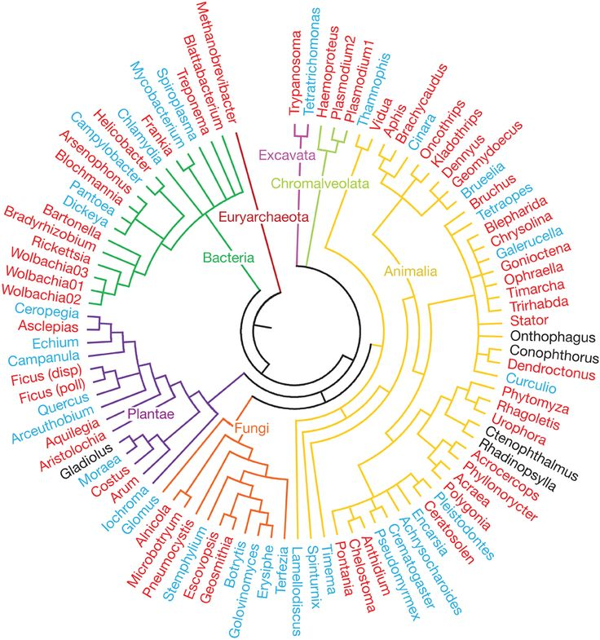
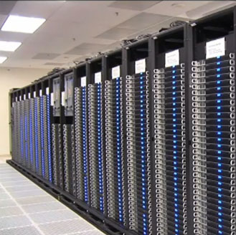
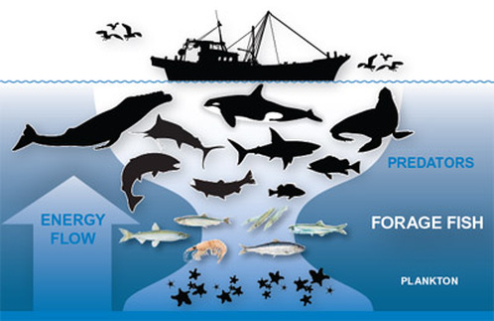
MBON Components
Environmental
Conditions
pH, T, Sal, O₂, CO₂, etc
Data Analysis And Modeling
PRODUCTS
Biodiversity Indicators, Indices and relationships
Biodiversity
Species & Abundance
Information Systems
Data archiving, standardization
Ecoystem
Function
Trophic Structure,, etc
Stakeholders,
Communication & Management

Slide 17
Where does MBON fit in the bigger picture of ocean observations
GOOS
Marine BON
US IOOS
Blue Planet
GEO
Biological Task Team
GEO BON
Review of available and emerging technology
Working Group 5 Marine Ecosystems

Slide 18
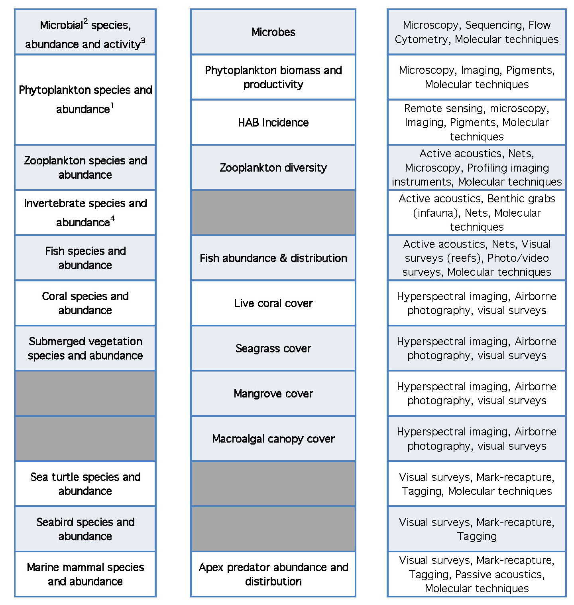
CORE
EOV
EBV
IOOS
GOOS
GEO BON
Genetic composition
Species populations
Species traits
Community composition
Ecosystem structure
Ecosystem function

Slide 19
Sustaining MBON’s in the Future
Demonstration MBONs need transition into operational systems
Need users that will support them
Need new technologies and methods
lower the cost
increases number of samples

Slide 20
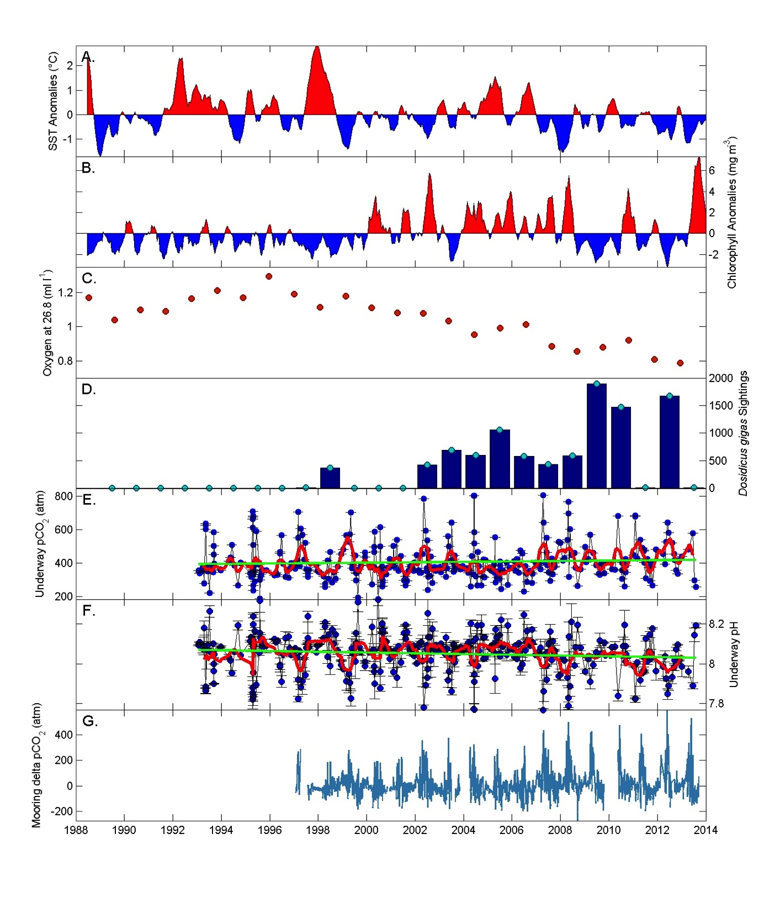
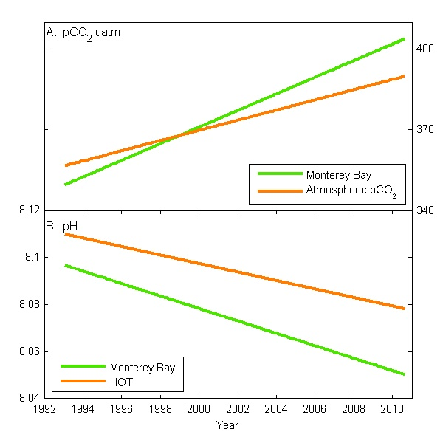
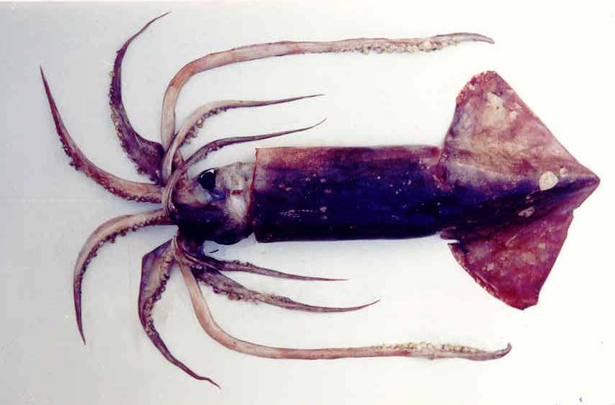
El Viejo La Vieja
Colder
More productive
Lower oxygen
Ecosystem change
Increasing CO₂
Decreasing pH
1992 2000 2010
Higher CO₂ events
As oxygen decreases, CO₂ and nitrate increase in upwelling source waters
1990 1995 2000 2005 2010

